Slide 1
Object Oriented Programming
(SENG6022)
Arba Minch University
Institute of Technology
Faculty of Computing & Software Engineering
Mr. Addisu M. (Asst. Prof)
G2 SE - Regular

Slide 2
Polymorphism
Chapter Six

Slide 3
Outline
01
Polymorphism
02
Types of Polymorphism
03
Overloading vs Overriding

Slide 4
Polymorphism
  Derived from two Greek words:
    Poly – many
    Morphs – forms
    means “many forms” in literal sense
  By adding two functions with the same name but different parameters, polymorphism investigates how to construct and use two methods with the same name to carry out two distinct functionality
public class Main {
  public static void main(String[] args) {
    Multiplier.Multiply(3,5); //first method
    Multiplier.Multiply(3.5,5.1); //second method
  }
}

Slide 5
Polymorphism
  Polymorphic entity behaves differently under different scenarios
    E.g., binary operator ‘+’ (addition)
      takes two operands; when operands that are passed to ‘+’
        numbers, an addition operation that returns the sum of two numbers is performed
      change to String type, ‘+’ operator does not add the String objects but concatenates or joins contents of the string to form a resultant third string

Slide 6
Polymorphism
Examples of polymorphism in the real life
  (1) Related to person
  Suppose you are in a classroom that time you behave like a student.
  When you at your home at that time you behave like a son or daughter or brother
  When you are in a market, you behave like a customer
  (2) Related to product
  Suppose Air Conditioner producing hot air in winter and cold air in summer

Slide 7

Polymorphism
Examples of polymorphism in the real life
  Man is only one, but he takes multiple roles like – he is a dad to his child, he is an employee, a salesperson and many more
  A cell phone to save Contacts
    a person has two contact numbers - create a function like
  void createContact(String name, int num1, int num2)

Slide 8
Polymorphism
  Inheritance allows you to define a base class and derive classes from base class
  Polymorphism allows you to make changes in the method definition for the derived classes and have those changes apply to methods written in the base class
  polymorphism literally means “having many forms”
    ability of an object to take different forms of objects
    ability for the same code to be used with different types of objects and behave differently with each.
  All objects are polymorphic as they all are derived from “Object” class and thus fulfill ‘IS-A” r/p with Object class
    An object is always accessed through a reference variable of that particular class type.

Slide 9
Polymorphism
  Once a reference variable of a particular type is declared, it cannot be modified
  For example, if there is ABC class and class XYZ derived from ABC, both classes have a polymorphic method func ()
class ABC{
void func(){}
}
class XYZ extends ABC{
void func() {}
}
  Create a reference of type ABC
obj = new XYZ ();
  func() has d/t implementations but the same prototype
  Depending on the object pointed by reference object, we have appropriate implementation in that scenario invoked

Slide 10
Example
  Suppose: we have a printName method in super class Person, and we override this method in both Student and Employee subclass's
    public class Student extends Person {
      public void printName(){
      System.out.println("Student Name" );
      }
    }
    public class Employee extends Person {
      public void printName(){
      System.out.println(" Employee Name" );
      }
    }
Person
Student
Employee

Slide 11
Example
  In Java, we can create a reference that is of type super class, Person, to an object of its subclass, Student
    public static main(String[] args) {
      Student studObject = new Student();
      Employee empObject = new Employee();
      // Person reference point to a Student object
      Person ref = studObject;
      // Calling printName() of the Student object instance
      ref.printName();
    }
If you try to call the printName method of the reference Person ref, printName method of the Student object will be called.
If we assign ref to an Employee object, printName method of Employee will be called

Slide 12
Types Of Polymorphism
  Java supports two types of Polymorphism:
    Compile time or static polymorphism
    Run time or dynamic polymorphism
Polymorphism
Compile-time polymorphism
Method Overloading
Operator Overloading
Run-time polymorphism
Method Overriding

Slide 13
Types Of Polymorphism
Compile-time Polymorphism
also known as Static polymorphism
overload either the method or operator
Run-time Polymorphism
also known as dynamic polymorphism
implemented through Overloading
achieved through Overriding
performed at compile-time
done at runtime
Declaring a method in sub class which is already present in parent class
class to have multiple methods with the same name but with d/t number, sequence or type of parameters

Slide 14
Types Of Polymorphism
Compile-Time Polymorphism
  decides which method to execute during compile time
  performed using Method (function) Overloading and Operator Overloading
    Method Overloading - when a class has multiple methods with the same name and/or return type but differing on the sequent, number, and types of arguments
    overloaded method is resolved at compile time
  How do we invoke overloaded methods? Or how does the compiler know which method is to be called?
    invocation of the exact method that matches the call is performed depending on the parameter list

Slide 15
Types Of Polymorphism
Compile-Time Polymorphism
Example
class Compiletime{
  static void contact(String fname, long num) {
  System.out.println("Name : " + fname + "\nNumber : " + num);
  }
  static void contact(String fname, String mail) {
  System.out.println("Name : " + fname + "\nEmail : " + mail);
  }
}
class Polymorphism{
  public static void main(String[] args) {
    Compiletime.contact("Soham", 1234567890);
    System.out.print("\n");
    Compiletime.contact("Soham", "soham@mail.com");
  }
}

Slide 16
Types Of Polymorphism
Compile-Time Polymorphism
  Similar to method overloading, we can override an operator
    we can overload only “+” operator in Java and do not support the overloading of other operators
    When we use String as operands between + it results in String concatenation
    When we use numbers as operands between + it results in the addition of two numbers

Slide 17
Types Of Polymorphism
Compile-Time Polymorphism
class Operatordemo {
  public void operator(String s1, String s2) {
    String s = s1 + s2;
    System.out.println("String concatenation: " + s);
  }
  public void operator(int x, int y) {
    int sum = x + y;
    System.out.println("Sum: " + sum);
  }
}
public class OperatorOverloading {
  public static void main(String[] args) {
    Operatordemo o = new Operatordemo();
    o.operator("Good", "Evening");
    o.operator(4, 9);
  }
}

Slide 18
Types Of Polymorphism
Runtime Polymorphism
  occurs when we have two or more classes, and all are interrelated through inheritance
  To achieve runtime polymorphism, we must build an "IS-A" relationship between classes and override a method
    Instead of resolving the overridden method at compile-time, it is resolved at runtime
  An overridden child class method is called through its parent's reference
    Then the method is evoked according to the type of object
    In runtime, JVM figures out the object type and the method belonging to that object

Slide 19
Types Of Polymorphism
Runtime Polymorphism
  It refers to the process when a call to an overridden process is resolved at the run time
  Based on the type of object we create, it calls the method of that corresponding class
    means, if we create an object of the superclass and refer it using the subclass, then it calls the method of the subclass
    compiler doesn’t determine the method to be executed
      It’s JVM that performs the process at the run time
  This happens among different classes
    When the subclass has the same method of the base class, we call it a method overriding
    Means - subclass has overridden the base class method

Slide 20
Method Overriding
  Whenever a parent(super) and child(sub) class both are having same method with same types of parameters
  Advantages of Java Method Overriding
  Method overriding is used to achieve run-time polymorphism
  Method overriding - used to provide own specific implementation of a method that is already provided by its super class
  Rules of Java Method Overriding
  Method must have same name as in the parent class
  Method must have same parameters as in the parent class.
  Must be IS-A relationship(inheritance)
  You can only override method in child(sub) class, you cannot override method in same class

Slide 21
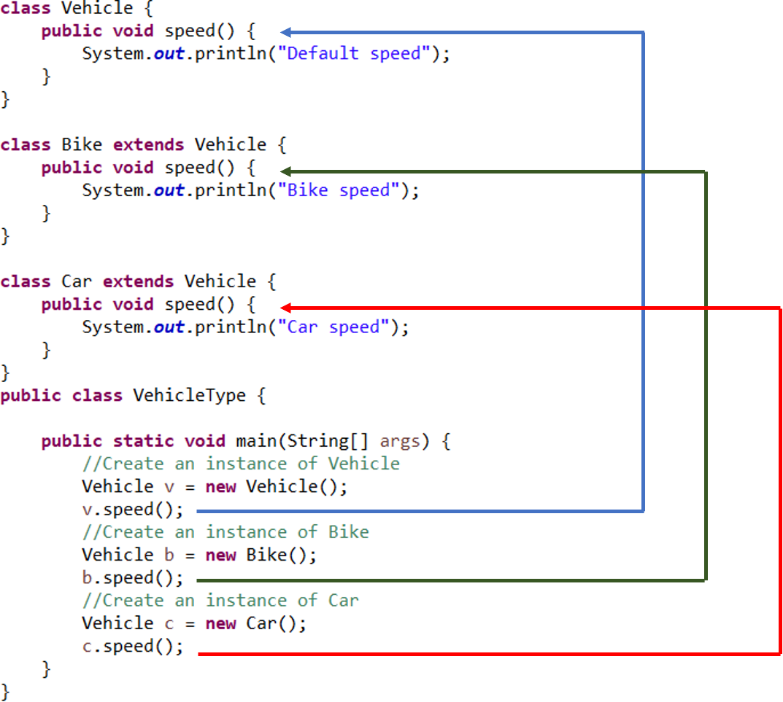
Method Overriding
If we create an object of instance Vehicle class and call speed method (v.speed) it calls parent class method
When we call the speed method using object created of instance Bike class(b.speed), it calls the Bike class method.
When we call method using the object created of instance Car class(c.speed), it calls the Car class method.
Example
Output
Default speed
Bike speed
Car speed

Slide 22
Method Overriding
Example
class Human{
  void eat(){
  System.out.println("Human is eating");
  }
}
class Boy extends Human{
  public static void main(String args[]){
    Boy b = new Boy();
    b.eat();
  }
}
Output:
Human is eating

Slide 23
Method Overriding
If you want to give the specific implementation of eat() method of its child class, you have to use method overriding
Example
class Human{
  void eat(){
  System.out.println("Human is eating");
  }
}
class Boy extends Human{
  void eat(){
  System.out.println("Boy is eating");
  }
  public static void main(String args[]){
    Boy b = new Boy();
    b.eat();
  }
}
Output:
Boy is eating

Slide 24
Difference between
Method Overloading
Method Overriding
used to provide the own specific implementation of a method that is already provided by its super class
occurs between two classes (through inheritance)
parameters should be the same
example of run time polymorphism
Inheritance is required
Child class method hide the super class method from access by child class object
used to increase the readability of the program.
occurs within the same class
parameters should be different
example of compile time polymorphism
Inheritance is not required
One overloaded method does not hide the other method

Slide 25
THANKS!
Questions, Ambiguities, Doubts, … ???

